Slide 1



A first glance of DVB-I over 5G: DVB-MABR over LTE-based 5G Broadcast
September 30, 2021
DVB Demos
@qualcomm
Thomas Stockhammer, Romain Bouqueau, Christophe Burdinat
  Qualcomm Incorporated jointly with ATEME, Viaccess-Orca and Motion Spell

Slide 2




DVB-I Service Layer for
DVB-I Headend (DVB-AVC,
DVB-DASH, DVB-MABR, DVB-I)
DVB-I over 5G Commercial Require-
ments completed in July 2021
5G Release-16 means
  LTE-based 5G Broadcast
  Unicast-based 5G Media Streaming
  Hybrid services
Service Layer based on DVB-I
  DVB-AVC codecs
  DVB-DASH incl Low-Latency DASH + CMAF
  DVB-MABR: ABR Multicast including ROUTE
  DVB-I Service Layer
Technical work has started in DVB
This is a first glance
M1d/M2d
xMB
Non-5G
IP/HTTP Network
5G Operator
with 5G Media
Streaming
5G Broadcast
System
5GC
BMSC
Unicast
(NR)
BCAST
(ENTV)
M6d
M7d
MBMS-API
DVB-I client (DVB-I metadata,
DVB-Codecs, DVB-DASH, DVB-MABR)
Notes:
45s

Slide 3
FFFocus of this demo
A first glance of DVB-I over 5G
Feasibility
  Reception of "DVB-I over 5G live broadcast-signal" on 5G mobile device
Functionality
  Basic broadcast distribution of DVB-DASH content
  Low-latency distribution using LL-DASH/CMAF and ROUTE
  Seamless broadcast coverage extension with unicast fall-back
Future-proof
  Off-the shelf tools: commercial phones, stock DVB-DASH players, etc.
  Open source: dash.js, GPAC ROUTE, etc.
Notes:
45s

Slide 4
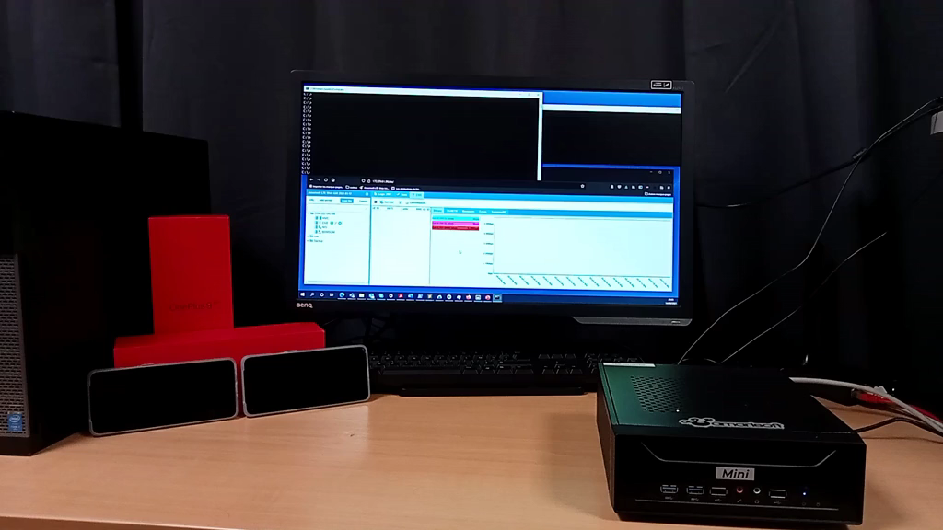

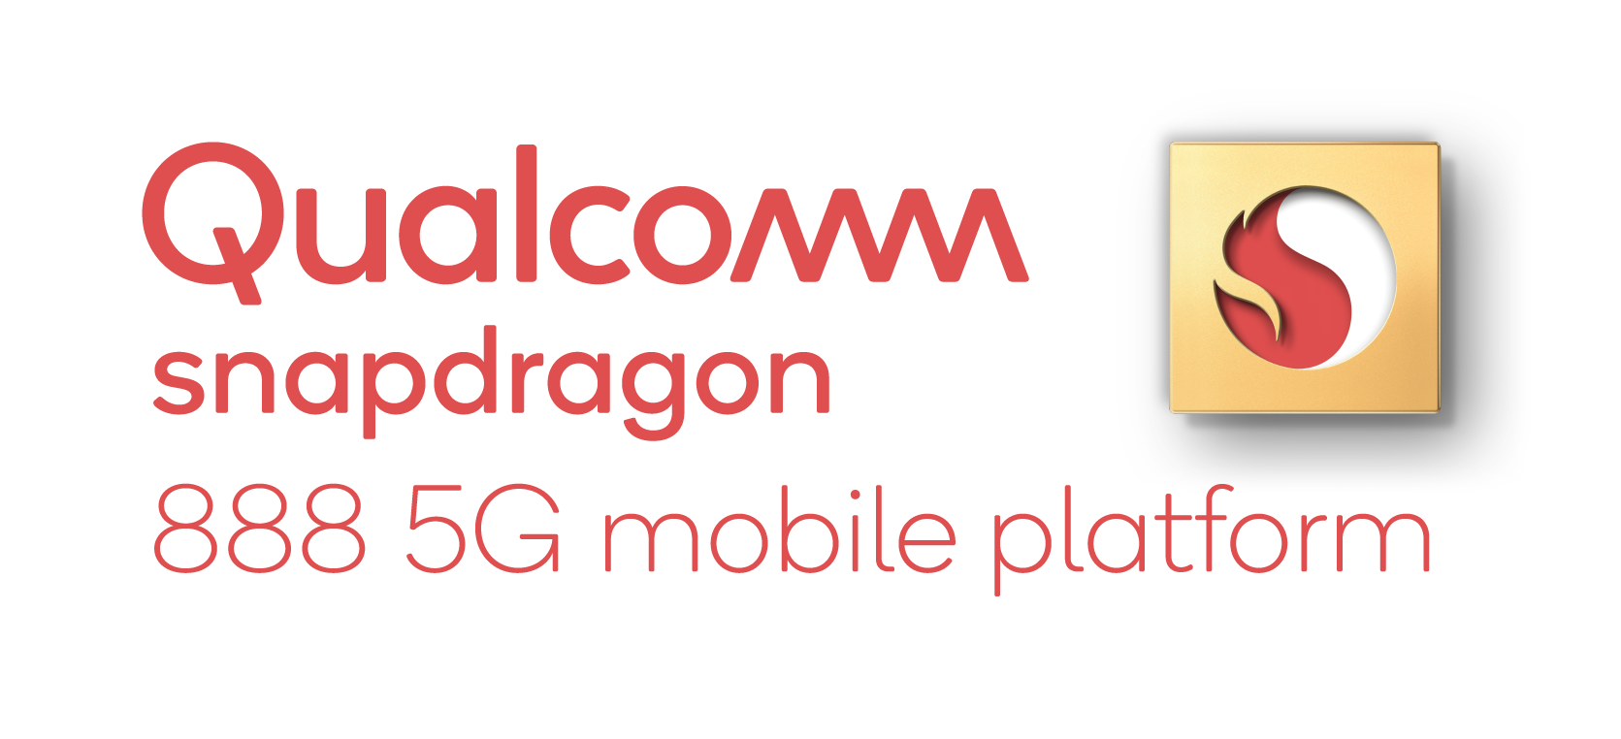


Demo 1: Feasibility
DVB-I over LTE-based 5G Broadcast
Live
OnePlus 9
DVB-AVC
DVB-DASH
DVB-DASH and AVC
Client
DVB-MABR
ROUTE Server
LTE-based 5G Broadcast
Transmitter
LTE-based 5G Broadcast
receiver
DVB-MABR
ROUTE Client
LTE enTV
radio bearer
Notes:
120s

Slide 6



Demo 2: Functionalities
Low-Latency & Hybrid Service Continuity
Live
DVB-AVC
DVB-LL-DASH
5G System
Media Streaming
unicast
Smart
Gateway
DVB-LL-DASH & AVC
Client
DVB-MABR
LL-ROUTE Server
LTE-based 5G Broadcast Emulator
DVB-MABR
ROUTE
Gateway
Notes:
120s

Slide 8
Future
Available Open Source Tools
  To be added GPAC, dash.js, Akamai source
Next Steps
  Combination of feasibility and functionalities
  Adding additional functionalities
  Integration into 5G-MAG Reference Tools
For more details on setup and command lines, please contact us or join us in the afternoon
Notes:
30s

