Slide 1
How to take clear recordings using the CTA WAVE Device Observation Framework
Camera and environment set up
Provided by Resillion UK Limited

Slide 2
Camera and Device Set Up
The device must be mounted on a stable stand/support.
The camera must be mounted on a stable tripod/support.
The camera lens must point directly at the device screen at a 90 degree angle.
The camera shall directly capture the DUT screen. Do not cast the screen to a different device to then record. Recording a screen cast to may cause missing frames.
Wired audio recording should be used for audio only (S8 audio tests) and combined video audio tests (S9 tests).

Slide 3

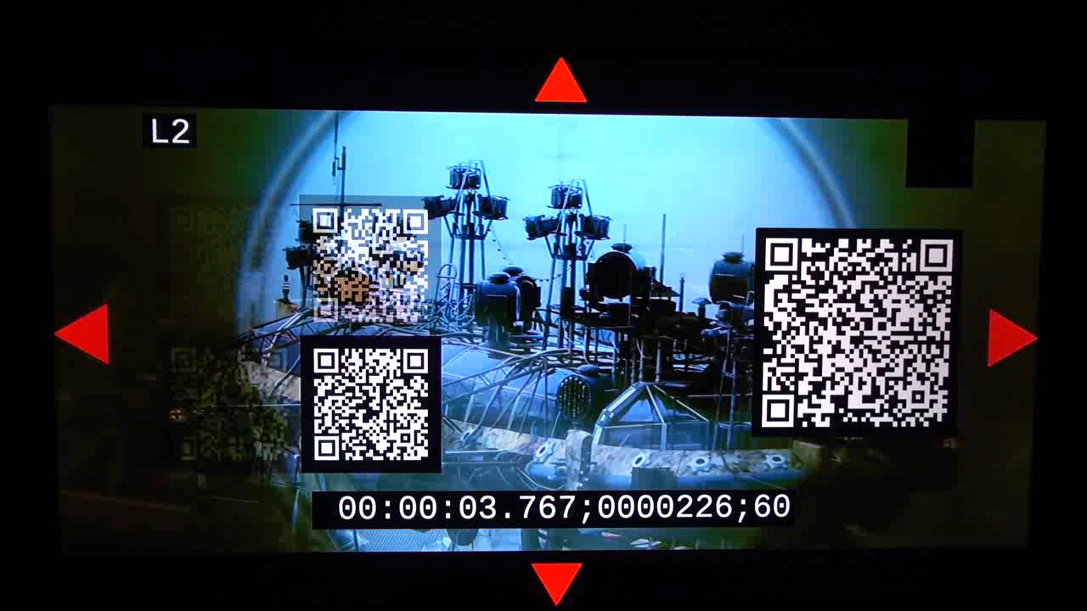
Without stable support / mount

Slide 4
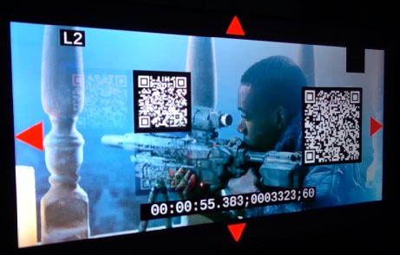
Camera not pointing at 90° to screen

Slide 5
Environment set up
The device must be in a light-controlled environment with no bright surrounding lights, and no glare or reflections on the device screen.
The device screen must not be obscured by anything, for example trailing cables, mouse cursor, etc.

Slide 6
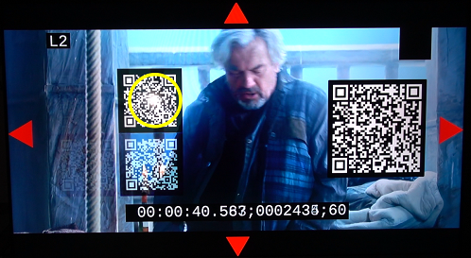
Reflections on the device screen

Slide 7
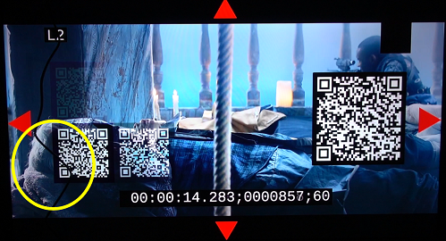
Screen partially obscured by trailing cable

Slide 8
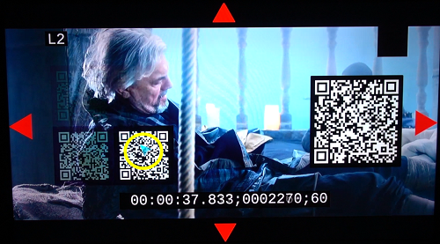
Screen partially obscured by cursor

Slide 9
Device set up
The device's screen brightness must be adjusted to be neither too bright nor too dim.
too dim and the QR code cannot be discerned.
too bright and the white will "bleed" and prevent the QR code being recognised.
The environment light source and camera exposure settings will also impact on the brightness of the recordings.
Increasing screen brightness in dark room may cause the QR code to bleed.
Reducing the screen brightness in bright room may cause the QR code not to be captured.

Slide 10
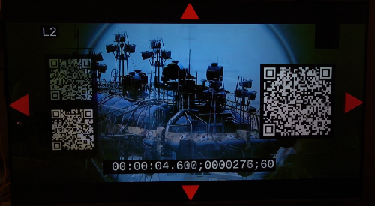
Device display is too dim

Slide 11
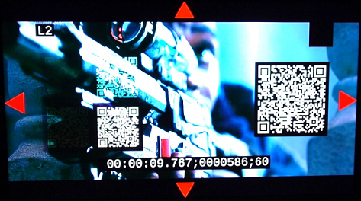
Device display is too bright

Slide 12
Camera set up
The camera must be set to record at a minimum of around 120 frames per second in full HD (we note some cameras may not record at exactly 120fps).
The camera should be zoomed in to capture the display as large as possible whilst still containing all the screen image including the red edge markers.
Adjust lens settings accordingly to avoid lens distortion.
The camera must be manually focused on the device screen to produce a sharp image.
do not use auto-focus. This may drift during a recording session depending on the images on screen.

Slide 13
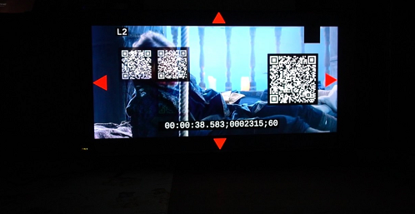
Camera is zoomed out too far

Slide 14
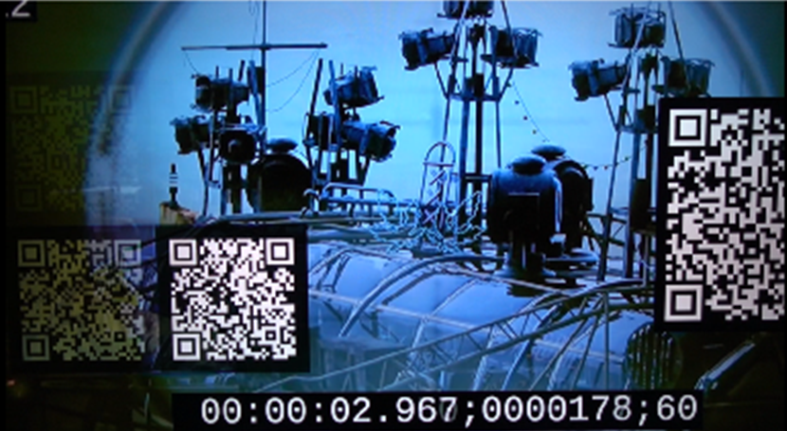
Camera is zoomed in too close

Slide 15
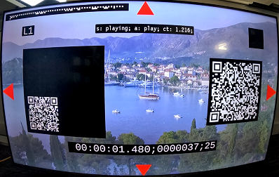
Lens set to wide view

Slide 16
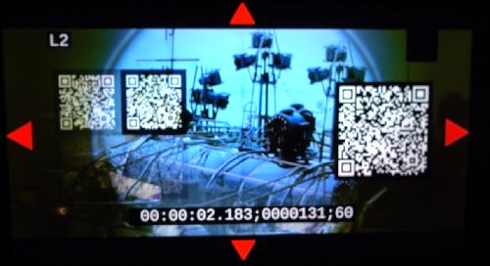
Camera is out of focus

Slide 17
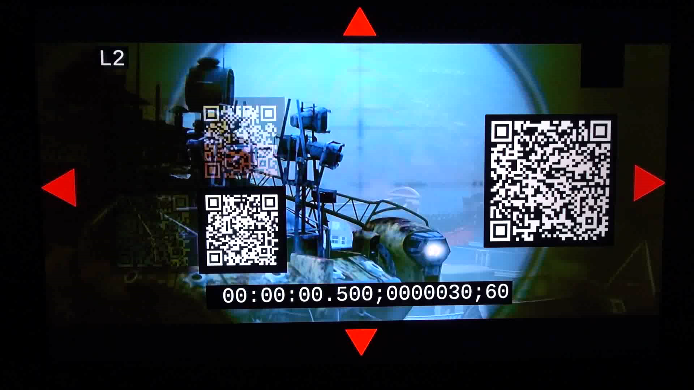
Camera is using auto focus (which may drift)

Slide 18
Recording duration
The recording must be started prior to the Test Runner session starting, and stopped after the session has completed.
Note the Observation Framework relies on detecting QR codes presented before and after the test video is displayed.
Only one test session shall be contained in a single recording.
A single session may contain multiple tests.
Long duration test must be recorded on its own.

Slide 19
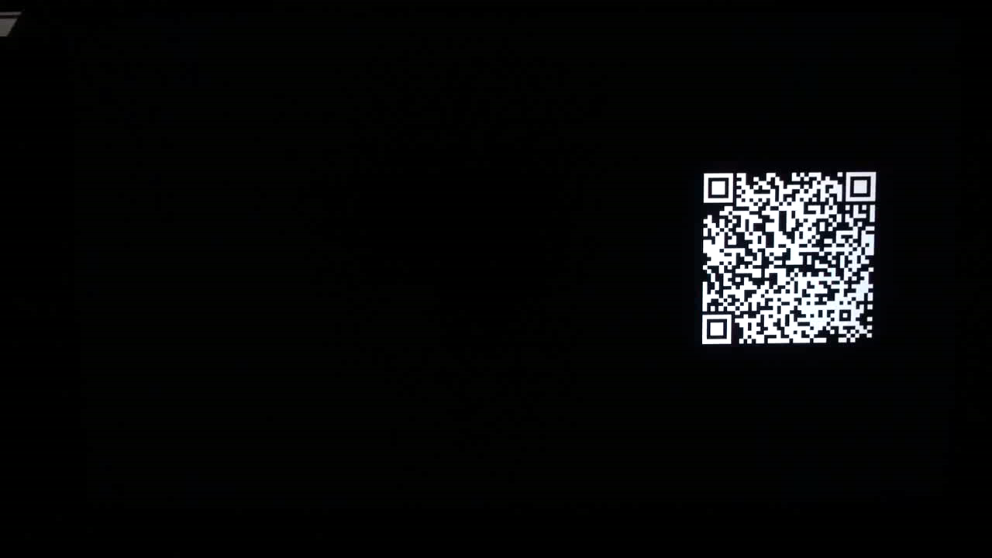
Delayed recording start: pre-test QR code is missing

Slide 20
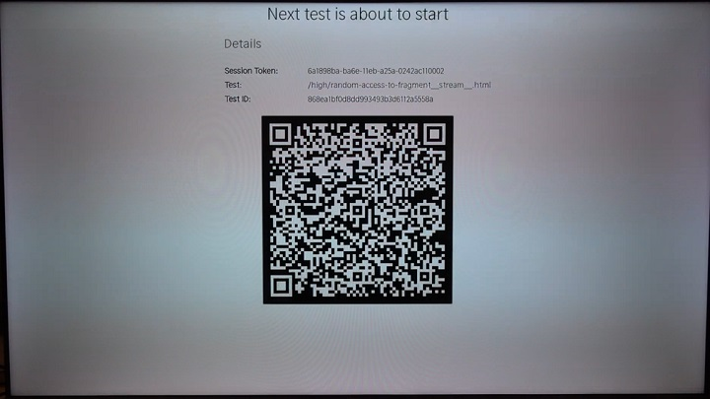
pre-test QR code as follows must be included

Slide 21
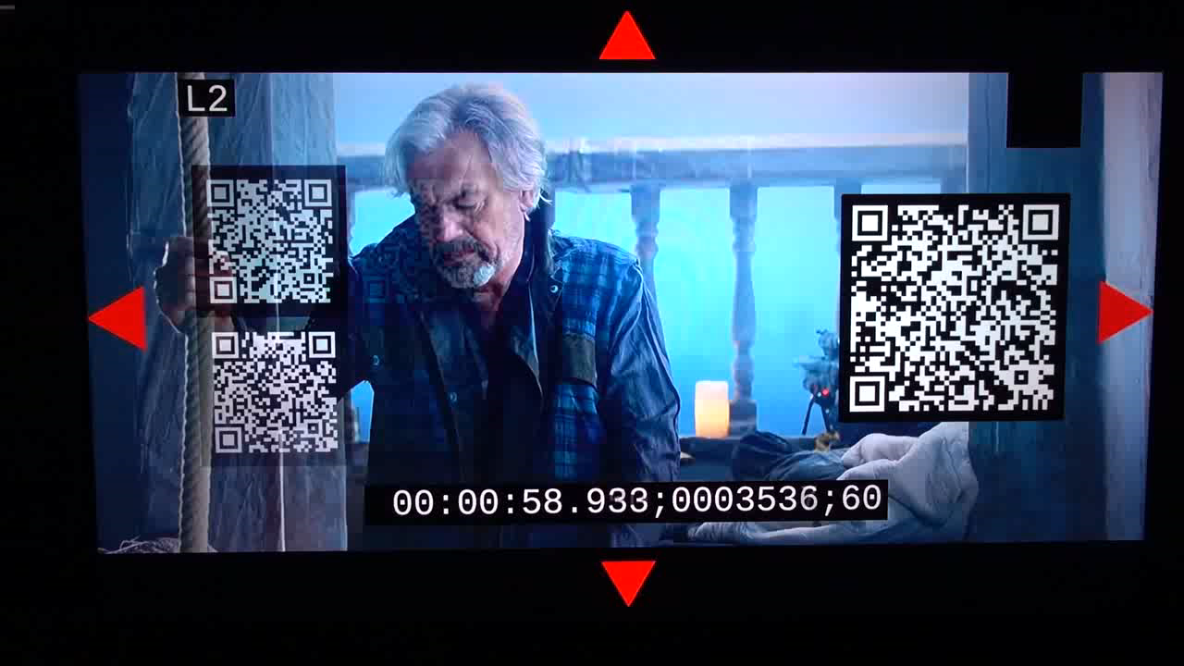
Recording stopped too soon: end test QR codes missing

Slide 22
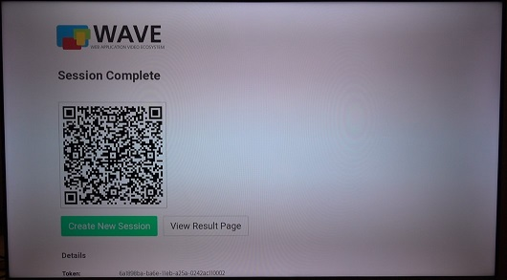
Stop recording when full test session is completed
User will see the following screen when a test session is completed

